Slide 1

LEOPARD: Lightweight Edge-Oriented Partitioning and Replication for Dynamic Graphs Jiewen Huang Daniel J. Abadi Yale University Yale University jiewen.huang@yale.edu dna@cs.yale.edu VLDB, 2016
张钰波
Dec. 02, 2020

Slide 2
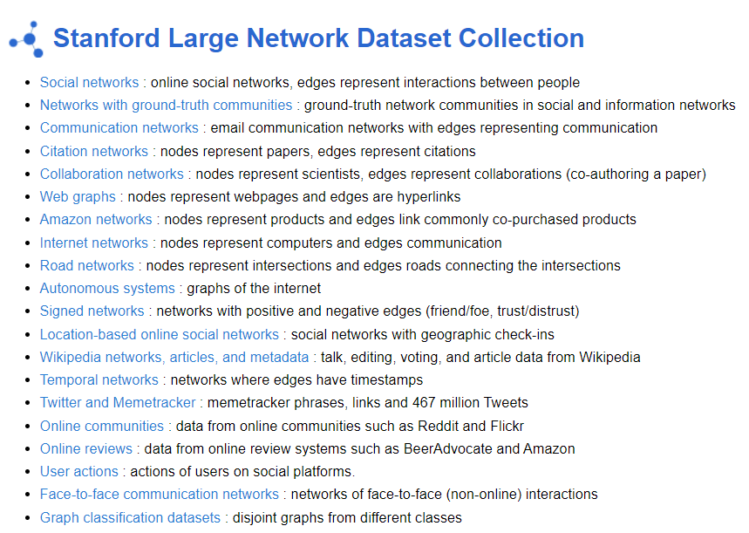
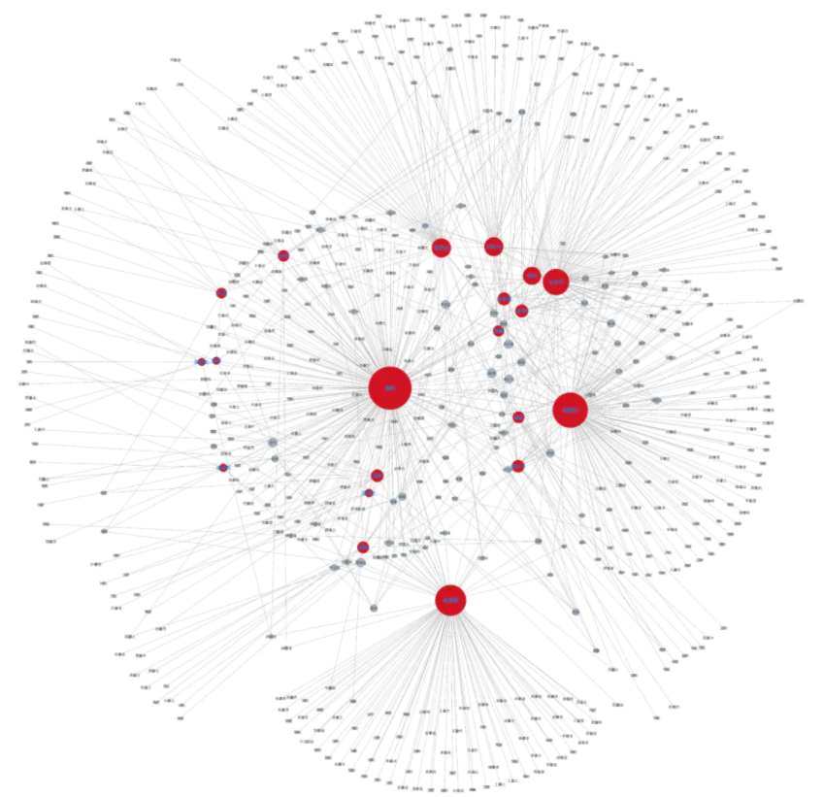
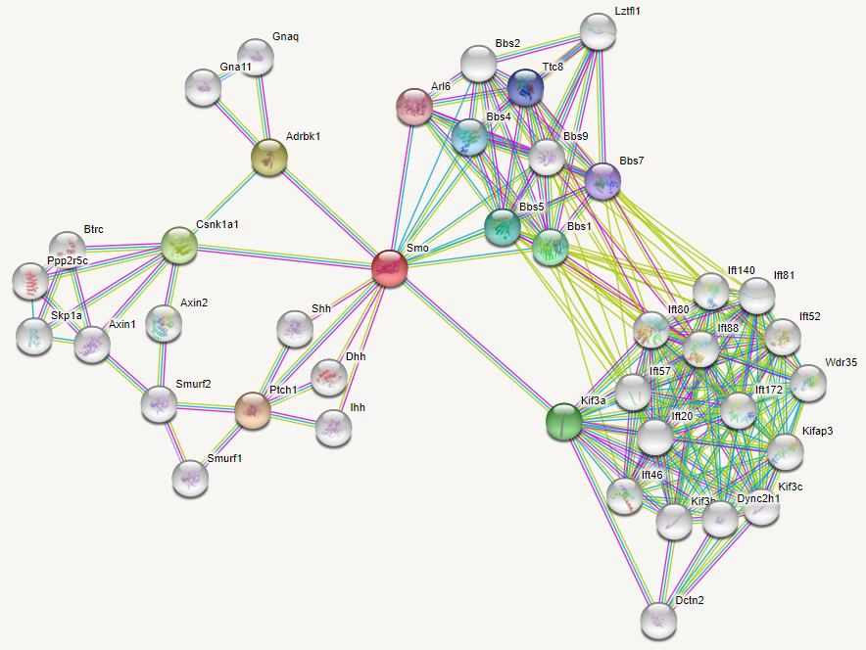
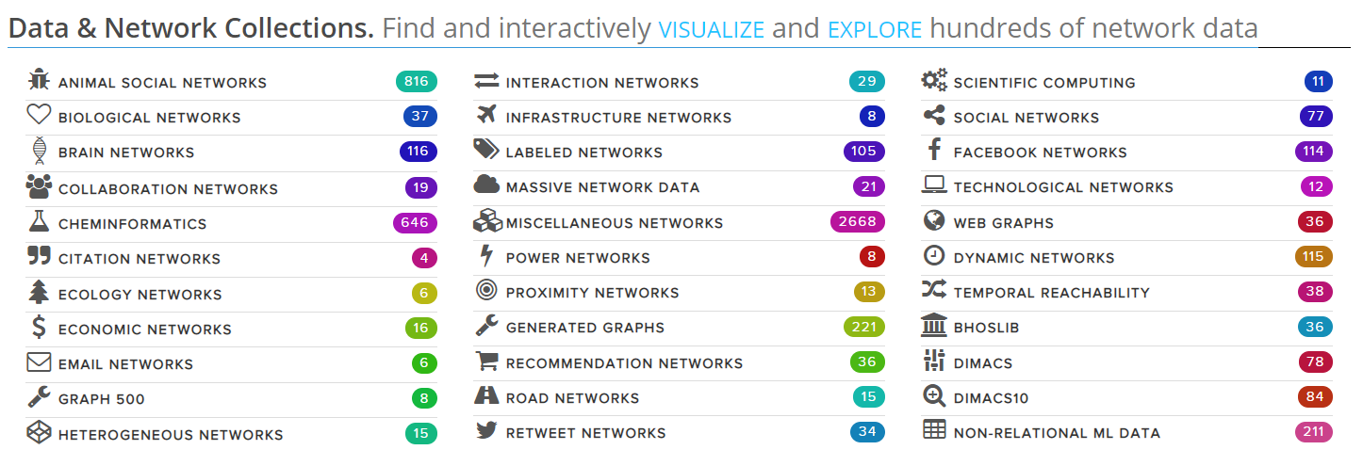
Background
http://snap.stanford.edu/data/
Social network
Protein-protein interaction network
http://networkrepository.com/index.php

Slide 3
Background
Significance
Static graph partition
Streaming graph partition
Dynamic graph partition
Large scale
Data changes frequently
Minimum Cut
Load Balancing

Slide 4
Background
Research status
Most of the research focus on repartitioning the graph after a batch of changes are made to an original partitioning that cause the original partitioning to deteriorate.
Some research do not consider replication as a mechanism for improving edge-cut.
Some work has been done with replication, but not discuss repartitioning as the graph structure changes over time.
K. Schloegel, G. Karypis, and V. Kumar. Sourcebook of parallel computing. chapter Graph Partitioning for High-performance Scientific Simulations. 2003.
L. Vaquero, F. Cuadrado, D. Logothetis, and C. Martella. Adaptive partitioning for large-scale dynamic graphs. In ICDCS ’14.
N. Xu, L. Chen, and B. Cui. Loggp: A log-based dynamic graph partitioning method. PVLDB, 2014.
J. Mondal and A. Deshpande. Managing large dynamic graphs efficiently. In SIGMOD ’12.
J. M. Pujol, V. Erramilli, G. Siganos, X. Yang, N. Laoutaris, P. Chhabra, and P. Rodriguez. The little engine(s) that could: scaling online social networks. In SIGCOMM ’10.

Slide 5


Approach
Partition selection
Number of copies
Vertex assignment
Vertex selection for reassignment
Partitioning
Replication

Slide 6
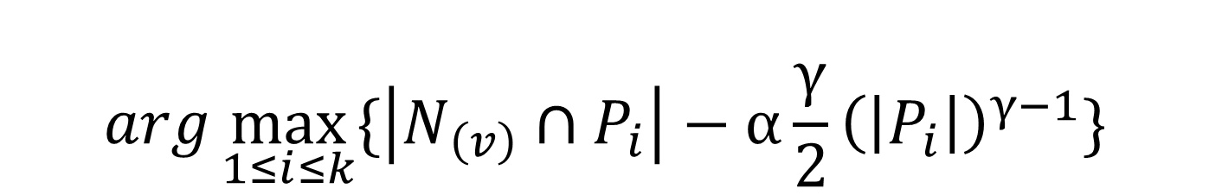
Partitioning
FENNEL
the vertices in the $i_{th}$ partition
$$arg\max_{1≤i≤k}{\{\left|N_{\left(v\right)}∩P_{i}\right|−α\frac{γ}{2}{\left(\left|P_{i}\right|\right)}^{γ−1}\}}$$
the set of neighbors of v
penalty function
Disadvantage: (1) a vertex is assigned only once and never moves
(2) they do not consider deletes
(3) they do not consider replication
Charalampos Tsourakakis, Christos Gkantsidis, Bozidar Radunovic, and Milan Vojnovic. 2014. FENNEL: Streaming graph partitioning for massive scale graphs.

Slide 7
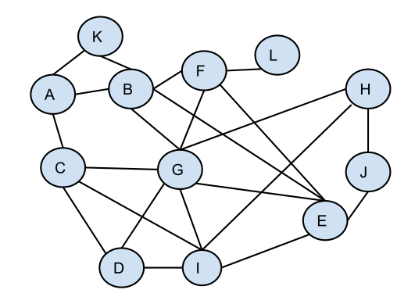
Partitioning
Identify vertices that may need to be reassigned
Candidate Set
H
1
H
G
2
J G I
J
·
.
.
I

Slide 8
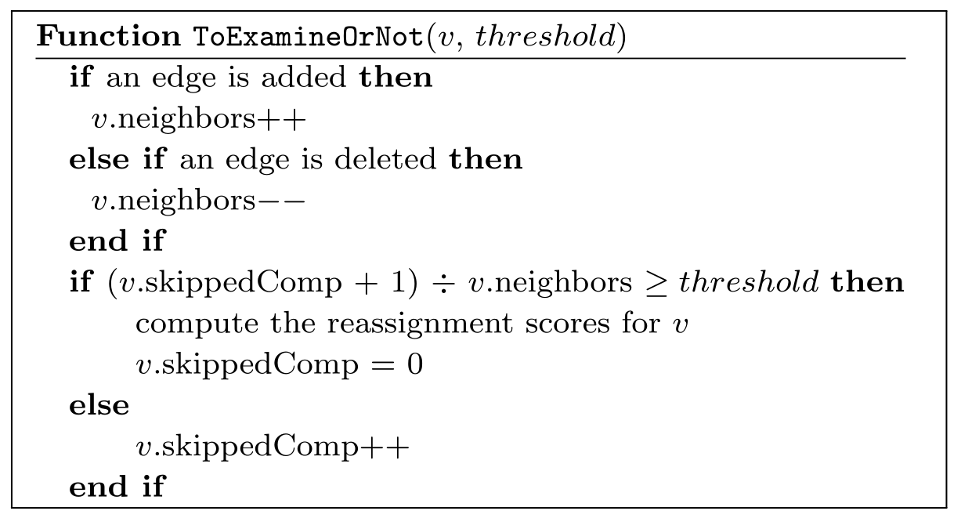
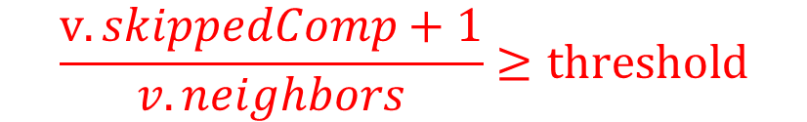
Partitioning
Timing of Reassignment Examination
Examination comes with a non-negligible cost.
It is less cost-efficient to pay the reassignment examination cost for a vertex with a large number of existing neighbors.
$$\frac{v.skippedComp+1}{v.neighbors}≥threshold$$

Slide 9

Replication
Minimum-Average Replication
Two parameters :
The minimum and average number of copies of vertices.
Two step :
First, running the vertex assignment scoring algorithm.
Second, the scores generated from the first step are ranked along with recent
scores from other vertices.

Slide 10
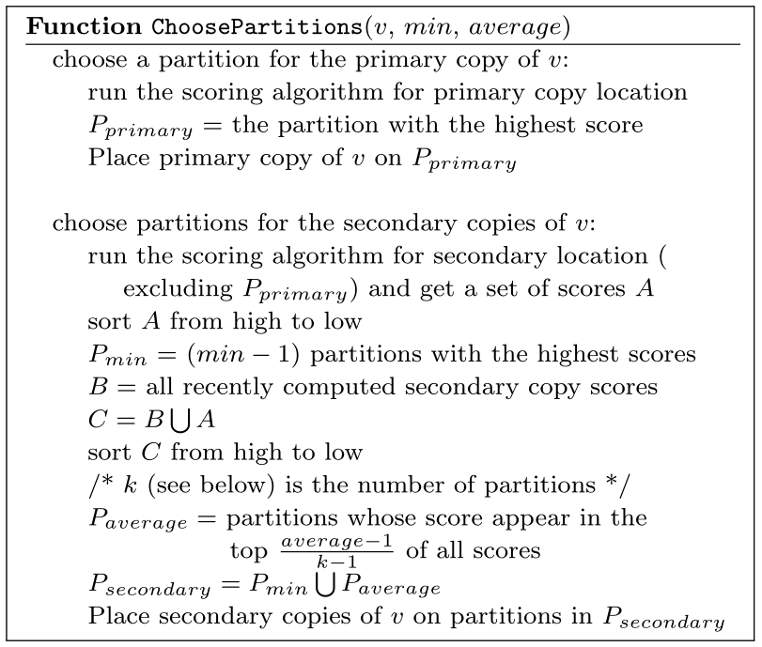
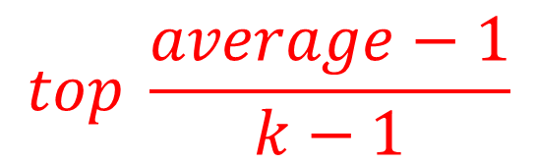
Replication
Minimum Replication
Average Replication
$$top \frac{average−1}{k−1}$$

Slide 11
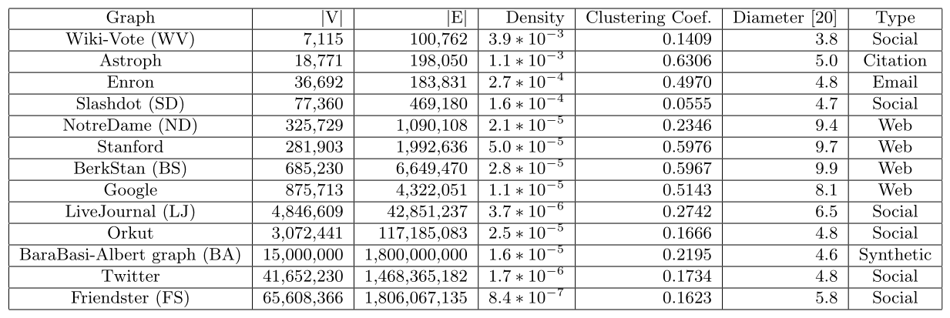
Evaluation
Statistics of the graphs used in the experiments

Slide 12

Evaluation
Five partitioning approaches
Leopard
The partition algorithm of this paper
FENNEL
Traditional streaming algorithms
METIS
SOTA static graph partitioning algorithm
Hash Partitioning
ParMETIS
Batch repartitioner
Still in widespread use
$$λ= \frac{the number of edges cut}{the total number of edges}$$
$ρ= \frac{the maximum of vertices in a partition}{the average number of vertices in a partition}$

Slide 13
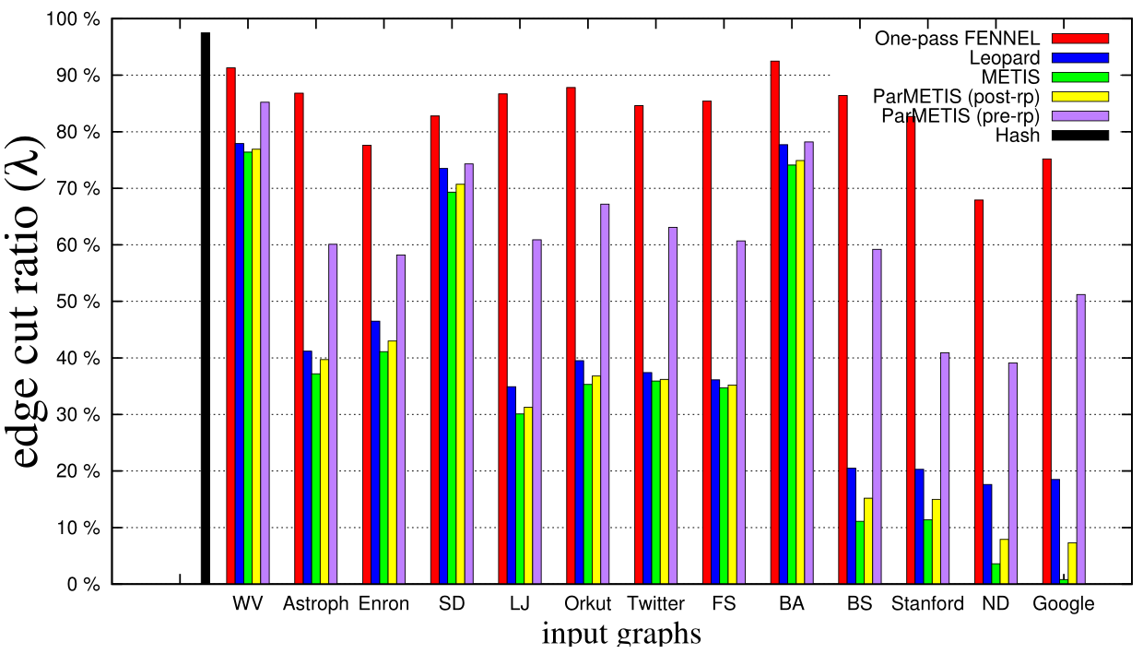
Evaluation
Partitioning quality in the absence of replication
The FENNEL algorithm is 44.6 times faster than Leopard
skipping optimization
This factor can be reduced to 2

Slide 14
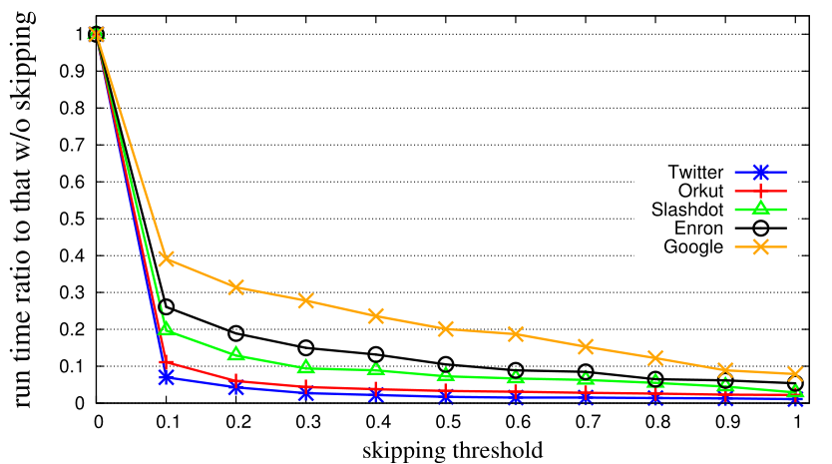
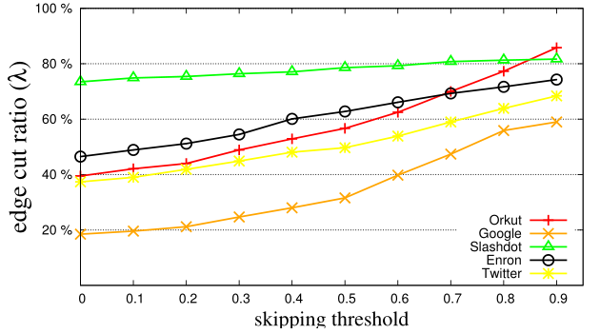
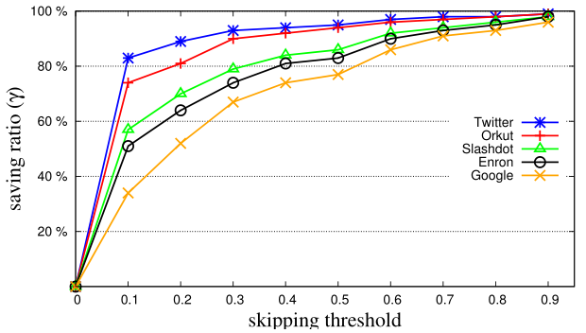
Evaluation
Skipping
$γ = \frac{number of vertices skipped for examination}{number of vertices examined at threshold 0}$

Slide 15
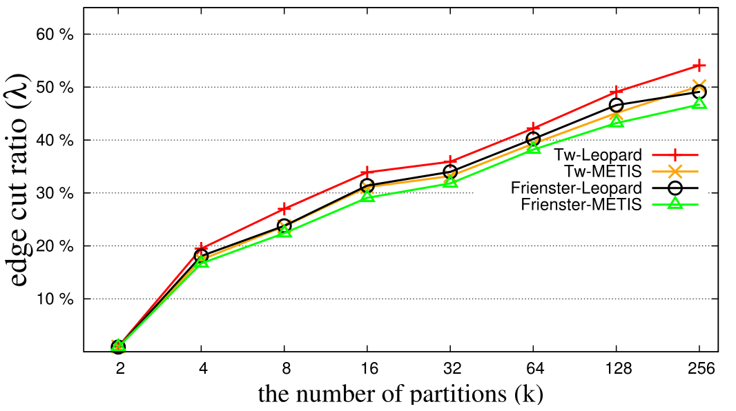
Evaluation
Scalability in the Number of Partitions

Slide 16
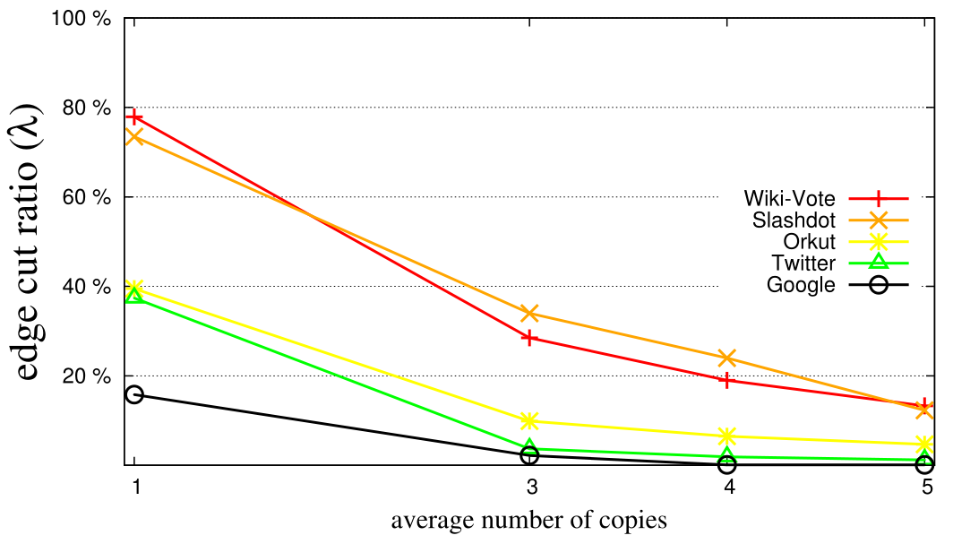
Evaluation
Leopard with replication

Slide 17
Summary
Leopard is designed for large-scale, constantly changing graphs.
By tightly integrating partitioning of dynamic graphs with replication, Leopard is able to efficiently achieve both fault tolerance and access locality.
It is only suitable for read-only graph computations.

Slide 18
Thank you !

